Slide 1


AWS + Clemson Makerspace Capstone Project
Final Presentation
+
Brayden Fidler, Andy Hsu, Reagan Leonard, Evan Moxley, Josh Norman
Notes:
Reagan - Hello everyone! My name is Reagan Leonard and I am the team leader of the AWS Capstone team. Brayden, Andy, Evan, Josh, and I have been working hard all semester alongside our AWS mentors, Owen and Miller, to provide a product to the Clemson Makerspace. The Makerspace, as most of you probably know, is a laboratory on Clemson’s campus equipped with 23 3D printers, 2 laser-cutters, and several other pieces of high-tech fabrication machinery. In this presentation, we will tell you all about our finished product and how we created it, including the decisions we had to make regarding the infrastructure and design of the system and UI.

Slide 2

Project Overview
Implementing a maintenance alert system for Makerspace employees
Proposed System
Old System
Web-based
Push Notifications
Backed up to the cloud
Provides insight
Paper spreadsheet
Notes:
Reagan - So the project we were tasked with for the semester was to essentially digitize the Clemson Makerspace’s maintenance system and add a feature that will alert the “Maintenance Team Lead” if a maintenance task is not completed.
The Makerspace machines need regular maintenance tasks performed on them, some daily, some weekly, and some monthly. Currently, the Makerspace employees simply look at a printed-out spreadsheet of what tasks are due when and they initial the spreadsheet when they have completed a task. This current solution, as the Makerspace employees acknowledge, is disorganized, error-prone, and most importantly, lacking accountability. The maintenance lead also has to physically go to the lab to check the spreadsheet as often as he or she can to see if any tasks were not completed.
Our solution to this is a serverless web app that aims to have not only push notifications that will elevate a task to the maintenance lead if left incomplete, but also proactive reminders to the employees to ensure they complete the tasks before they are due. We will also keep records of task completions to help provide insight into the Makerspace’s overall efficiency, while respecting the privacy of individual Makerspace employees.

Slide 3
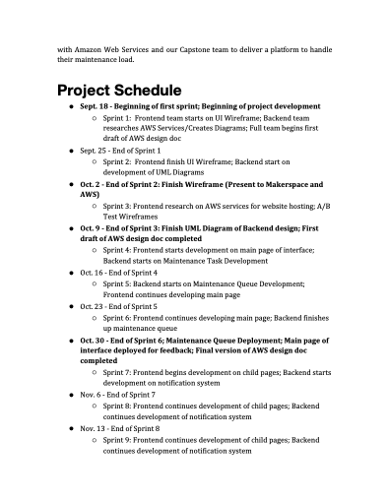
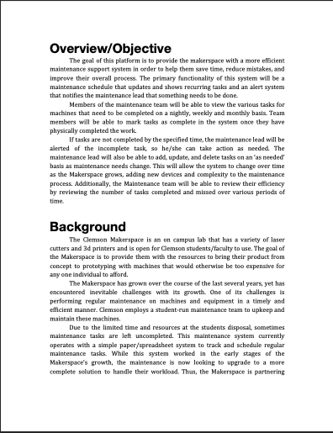
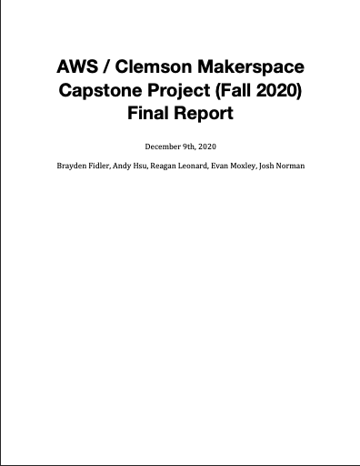
Project Timeline & Design
Sept. 18
Begin first sprint: Start research and project design
Oct. 2
Finish Interactive Wireframe Designs
Oct. 9
Finish Backend UML and Architecture Designs
Oct. 30
Maintenance Queue Deployment, Design Doc Completion, and Main Page Deployment
Nov. 20
Notification System Deployment; Entire UI deployed for testing
Nov. 27
Final testing of system begins
Dec. 4
Official end date of project; PRFAQ “released”
Notes:
Reagan - Here’s a quick look at what our project schedule looked like for this semester. Early in September, once we got a good handle on what our customer wanted, we created these milestones and, for the most part, we stuck to them! In some cases, we were even way ahead of schedule, particularly on the frontend side of things designing the UI.
And while it isn’t clearly shown by this timeline, I would like to point out that the first half of our semester’s work was heavily focused on creating an AWS Design Doc for our product. For those who aren’t familiar, this is a document that AWS development teams create before beginning any software project and they work iteratively on it throughout the project, thoroughly documenting their design and infrastructure decisions. To the right here are some screenshots of our Design Doc. We wanted to make sure we knew exactly what we were creating and exactly how we were going to do it before we really did anything else. And so most of our work prior to the end of October was focused on this Design Doc. The Frontend team didn’t even write our first line of code until October 12th and the Backend team didn’t start coding until October 19th. This made for a considerably shortened development period of just over a month and a half, but we believe it was worth it have a much clearer and unified vision for the design of the system.
Now I’m going to hand it off to Josh who’s going to talk a little bit more about our design.

Slide 4
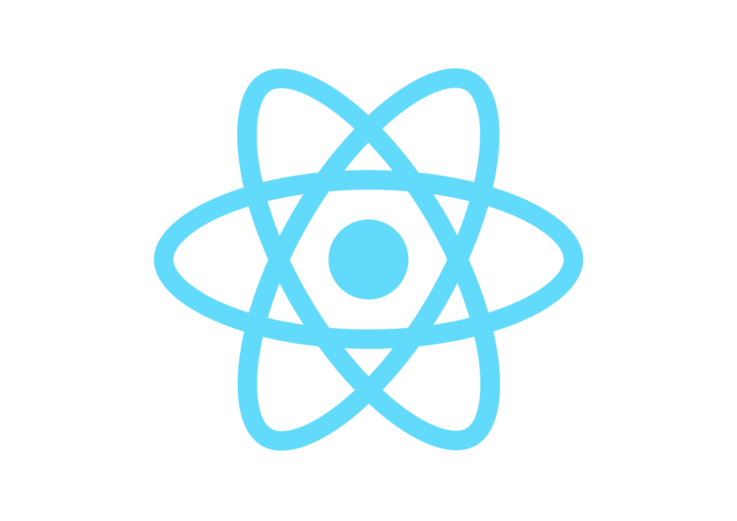
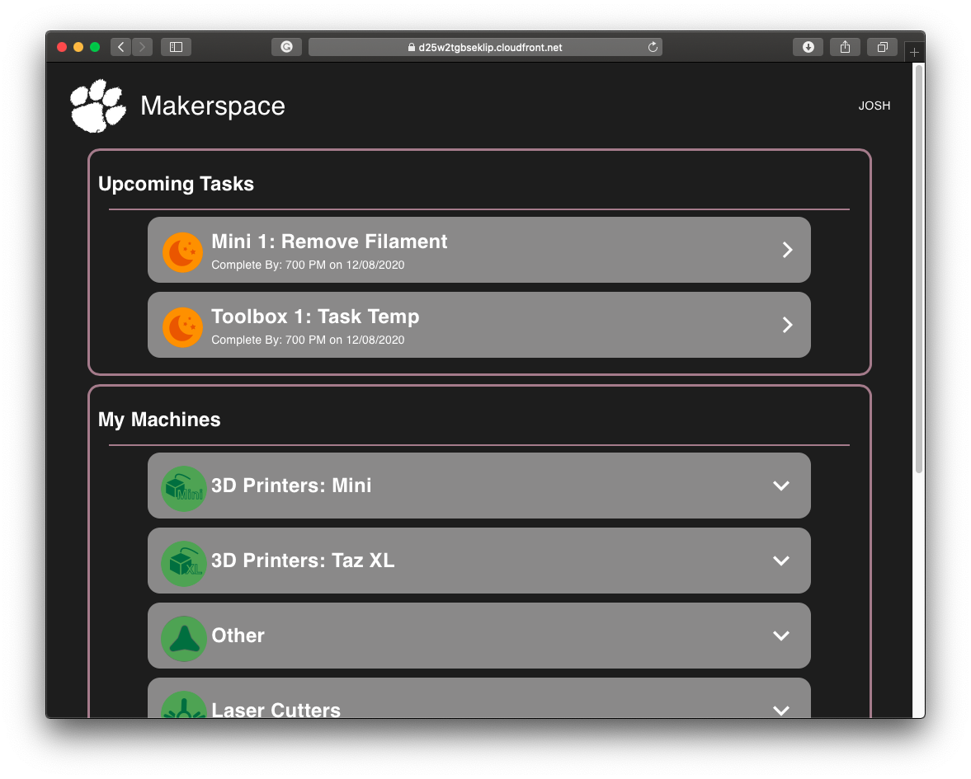
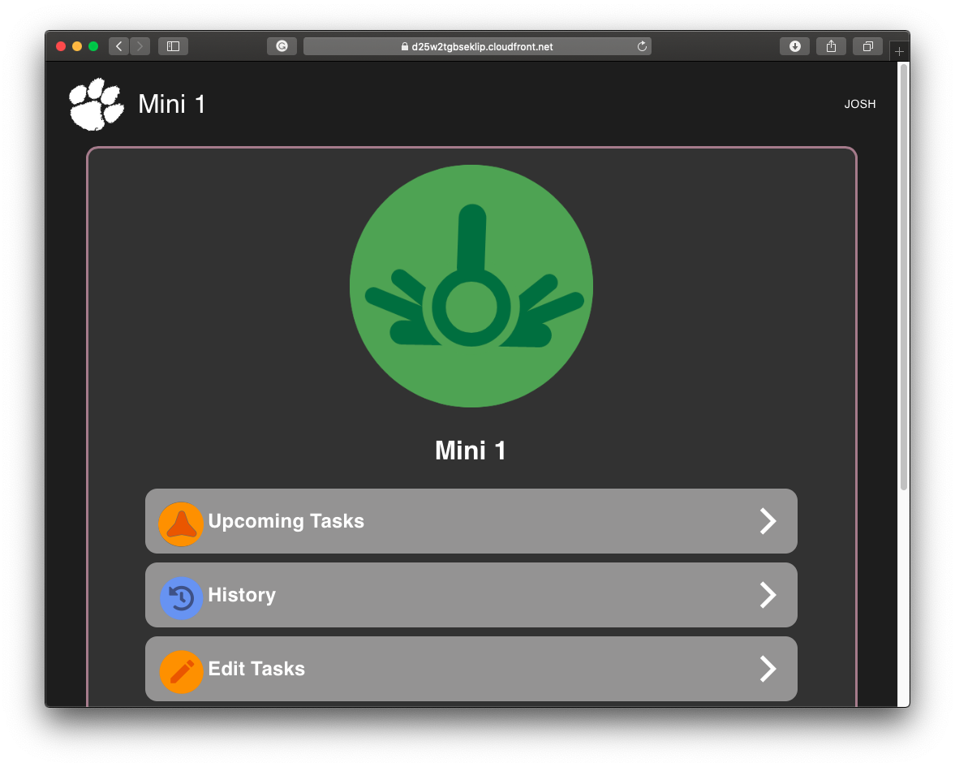
Frontend Implementation
Adobe XD
Custom Assets
React JS Framework
Modular
Compatible
Cognito Hosted UI
Notes:
Josh:

Slide 5

Demo
Notes:
Josh:

Slide 6
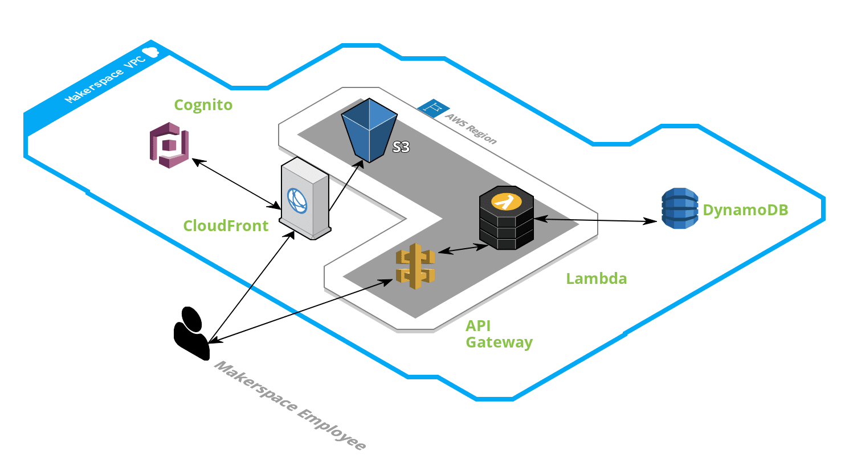
Infrastructure
Notes:
Evan: Thanks Josh, now I will be giving a brief overview of our project infrastructure, made up of different Amazon Web Services pictured here

Slide 7
Frontend Infrastructure
Notes:
So on the frontend side, the react code is stored in a static S3 bucket, hosted through CloudFront, and secured with Cognito. Cloudfront makes integration with our other AWS services, such as S3, seamless and secure. Using Cognito, also allows us to easily create a login system for our customer while still staying within the AWS free tier cost bracket.

Slide 8
Backend Infrastructure
Notes:
Next I will talk about the backend components which use API Gateway, Lambda, and DynamoDB. The backend of our web application has been broken down into separate Lambda functions, each of which interact with DyanmoDB. We then use the API Gateway to invoke each Lambda function and call it from the react code on the frontend side. These services allow us to retrieve data quickly while continuing to stay within the free tier of AWS services at no cost to our customer. They also allow for scalability and make it easy for future teams to add on to the existing backend functionality.

Slide 9

AWS CDK
Allows easy integration of AWS resources
Increases portability and reduces onboarding
Powered by CloudFormation, which allows repeatable deployment and simple rollback
Notes:
Andy:

Slide 10
CDK Deployment
Have an AWS account and install CDK CLI and CDK toolkit
Edit credentials in the command prompt
Run cdk init, cdk synth, & cdk deploy
Notes:
Andy:

Slide 11

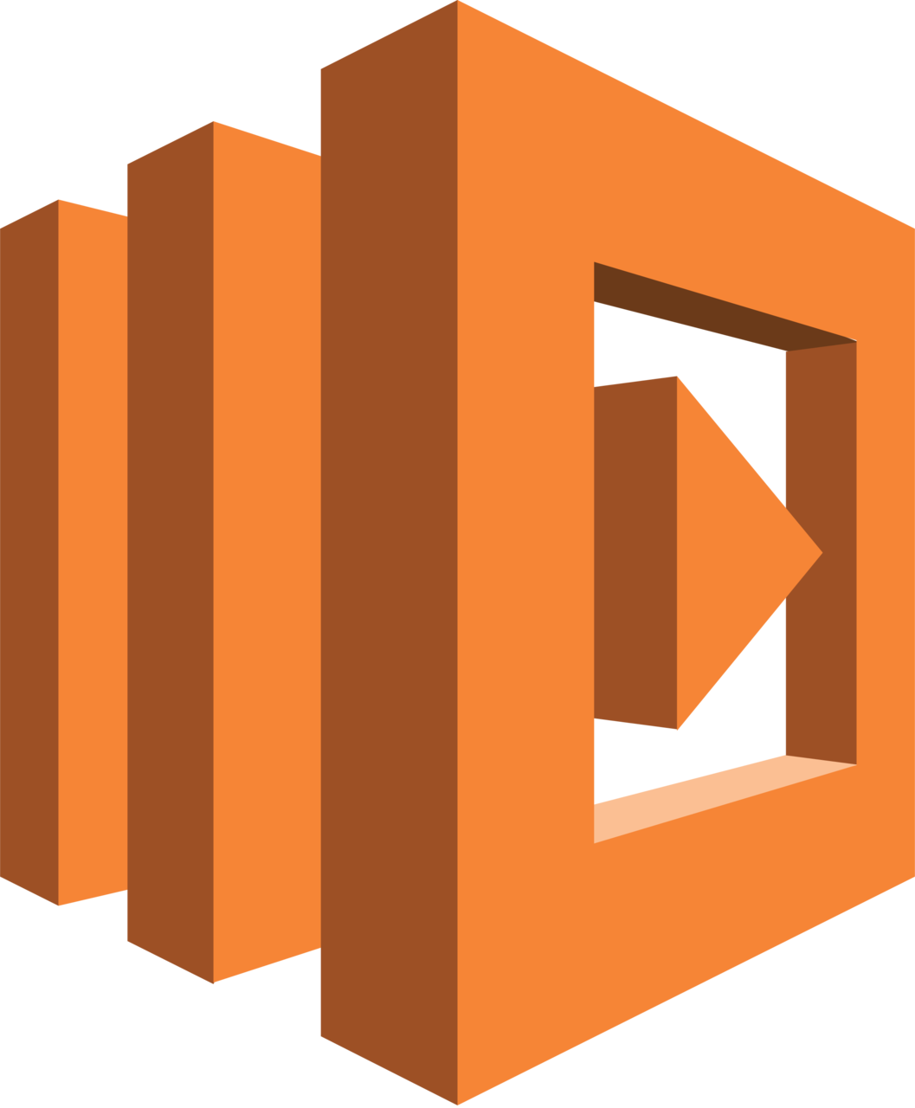
AWS API Gateway
API Calls
AWS Lambda
Machine Configuration
Add, View, Edit, Delete, etc.
Task Maintenance
Add, View, Edit, Delete, etc.
Task Completion
Reporting
Notification System
Export History (Excel)
Notes:
Brayden:
Going to go a little bit more in depth on back end and reiterate some of the things Evan talked about
API Gateway
Like a bridge between the back end and front end
Front End Code hits the Url provided by the API, which uses a Handler (Lambda Function) to determine responses to the request
AWS Lambda
Lambda is a serverless computing service from AWS. Automatically handles, resource allocation, scaling, logging, etc.
Powerhouse of AWS Cloud Computing Architecture
Our functions perform operations using our CDK Resources (DynamoDB, S3 Buckets, SES, etc.) and returns an HTTP Response.
AWS handles the rest.
API Calls
Categorized everything in our API in 3 categories.The Front end uses these to drive the application.
Example: Export History Function
Front End calls function using url.
API Gateway routes the request to our Lambda Function
If its a clean request, Lambda queries DynamoDB tables
It then writes an excel file an S3 Bucket and generate a temporary url
Finally returns an HTTP Response with the url to the bucket, which will download that file.

Slide 12
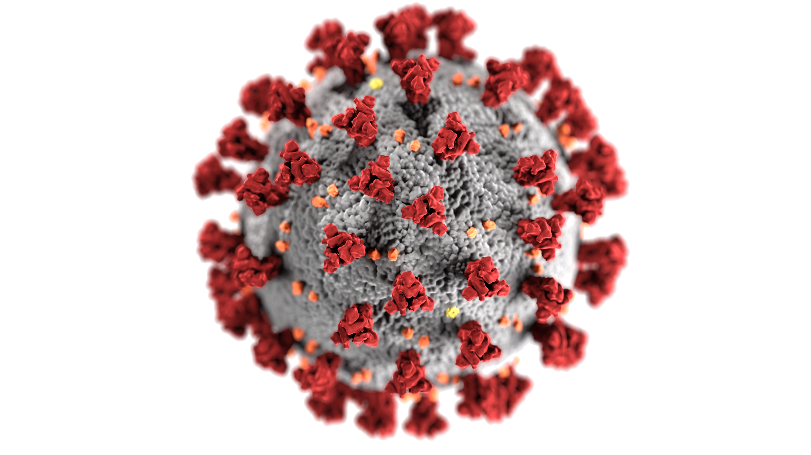
Challenges
React learning curve
AWS CDK familiarity
Development and Deployment Permissions
Team communication (COVID)
Uniqueness of project (client vs. customer)
Notes:
Brayden:
React
Josh/Reagan on Front End
Adobe’s response to Sketch. Both software are vector graphics editor.
Due to its variety of tools, its complexity is quite high. Adobe did not make this software beginner friendly either.
However, with time we were able to improve our skills and create polished designs.
AWS CDK
Andy/Evan/I on Back End
Andy has talked a little about the CDK already, but this is where all the AWS resources that power our product are defined.
Not only was it a challenge understanding each resource, but how to define and implement in the cdk. Very foreign at first.
Progress felt exponential rather than linear, however. Our velocity in the closing weeks was incredible once we were up to speed.
Permissions
Two fold - educate permission issues and makerspace issues.
Educate: we struggled to test SES (Simple Email Service) for notification system and Schedule Rules for Notification System and Task Maintenance.
Thankfully, both components had no issues once we actually deployed the app to the Makerspace AWS Account
Makerspace 1: Initially, we didn’t have to permissions to deploy at all because of base/additional CDK resource needs.
Fix was a simple as communicating with Owen, Miller, and Dr. Schweisinger to elevate our access.
Makerspace 2: Next we struggled to deploy and access s3 buckets defined in the CDK (very finicky).
Owen/Miller worked by side by side with us to help us debug the problem.
Fix is technical, but we changed to CDK to let our s3 buckets generate its own name (rather than give it one).
Next we passed the name to our Lambda Functions using environment variables (before we were just using the name we assigned in code).
Client/Customer
Our situation was unique in that we had AWS as our Capstone Client and Partner while the Clemson Makerspace Maintenance was our true customer.
For us that meant that Owen/Miller took on the role of mentors and facilitators while Meg and her team’s input was what truly mattered most in the final design.
Thankfully, Owen/Miller did an incredible job, going above and beyond to meet with us weekly, answer questions, and provide guidance.
Meg and her team were very explicitly with their needs, and her familiarity with Reagan made communication much easier.

Slide 13
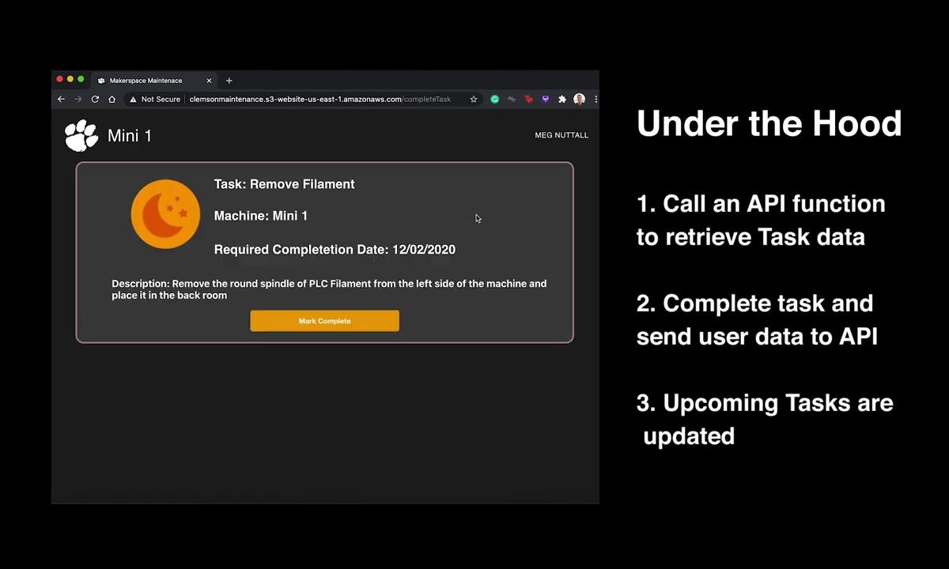
Notes:
Brayden:
So finally, we are going to play a short promotional video for you guys today.
It’s a culmination of all of the decisions we have made, challenges we have overcome, and work that we have put into this product.

Slide 14
Questions
+

